Slide 1




Data Science HACKATHON
OCCUPANCY DETECTION FOR ENERGY CONSERVATION
[H.WINNERS]

Slide 2
Company/
Business Profile
A Data Science team built on the vision of providing high tech fast and efficient business solutions for everyday problems.
H.WINNERS DATA SOLUTIONS

Slide 3
Member Profiles
Nana Yaa Pokuah-Debrah
Berlinda Asiedu
Sybil Meselebe
WOMEN IN TECH(Group 9)

Slide 4
[NAME]
[Problem Statement]
There is the need to conserve energy in homes, office spaces daily.
[Proposed Solution]
The proposed solution will be used to inform what time of the day and/or when to activate actuators to shut down the gadgets, devices such as ventilators in buildings.

Slide 5
[NAME]
[Data Findings]
Data Summary:
Size of 57001
Consists of 8143 records/rows & 7 columns
Feature Columns: Date, Temperature, Humidity, Light, CO2, HumidityRatio.
Target Column: Occupancy
3 different data types—float, integer, and object(datetime)
No duplicates & missing values
Data not normalized.

Slide 6
Hypotheses
The status of the occupancy of a room will depend on the time of the day.
Increased CO2 levels depict occupancy in a room.

Slide 7
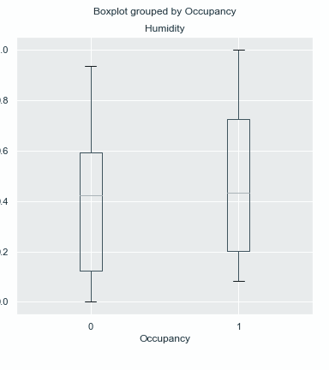
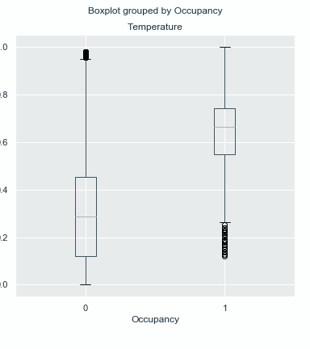
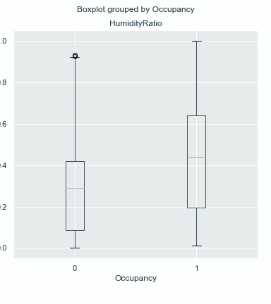
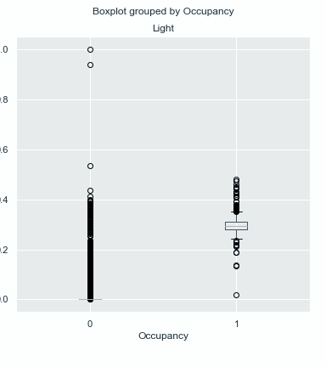
[Data Findings Continued...]
Feature Relationship with Occupancy

Slide 8
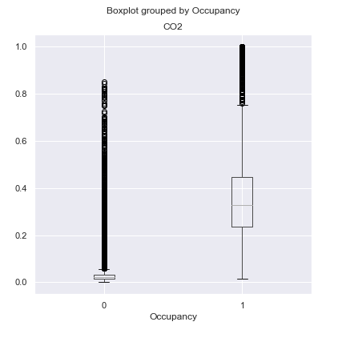
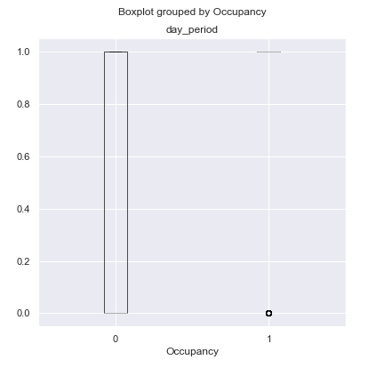
Temperature, Light, CO2 and day_period have their data have a clear unbalanced distribution between room occupancy and no room occupancy.

Slide 9
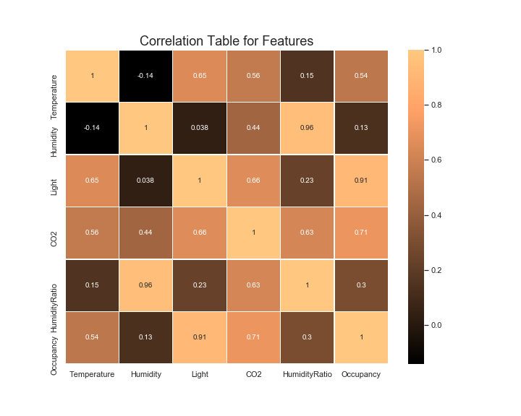
[Data Findings Continued...]
Correlation Matrix
It is observed that CO2 and light have a strong positive relation
Temperature has a moderate positive relation with occupancy.
Thus they may be more predictive of whether a room is occupied or not.

Slide 10
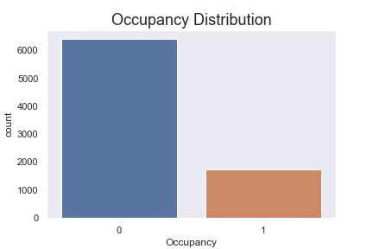
[Data Findings Continued...]
Imbalance in occupancy distribution.
Distribution shows higher occurrence for no occupancy than occupancy.
Can be attributed to time of the day.

Slide 11
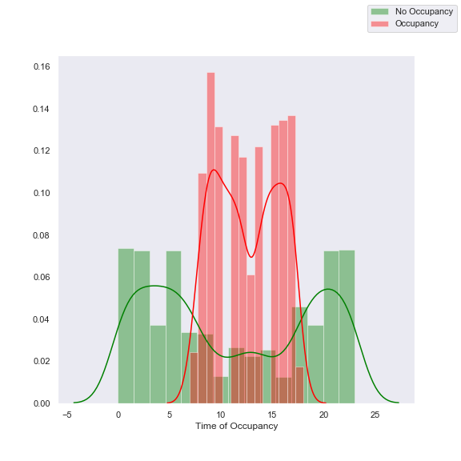
[Data Findings Continued...]
Imbalance in occupancy distribution.
Distribution shows higher occurrence for no occupancy than occupancy.
Can be attributed to time of the day.

Slide 12
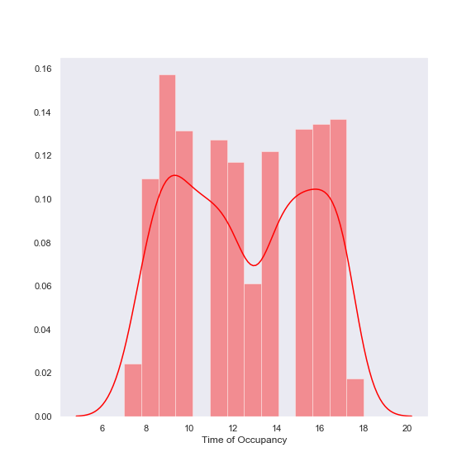
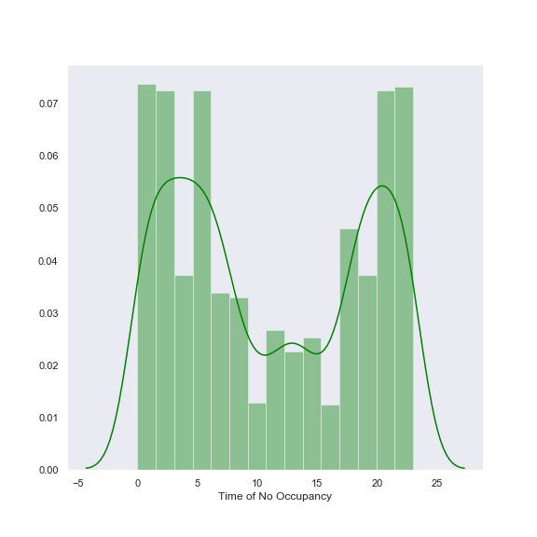
[NAME]
[Data Findings Continued...]

Slide 13
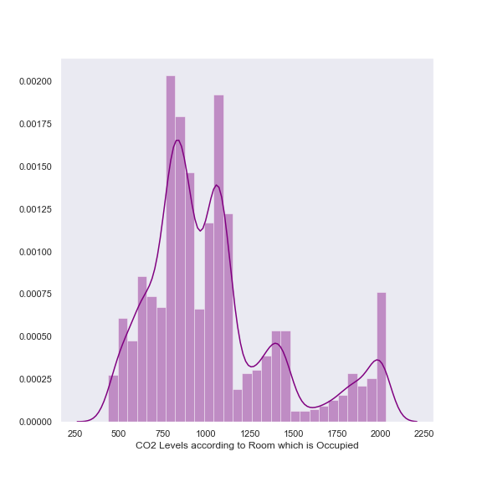
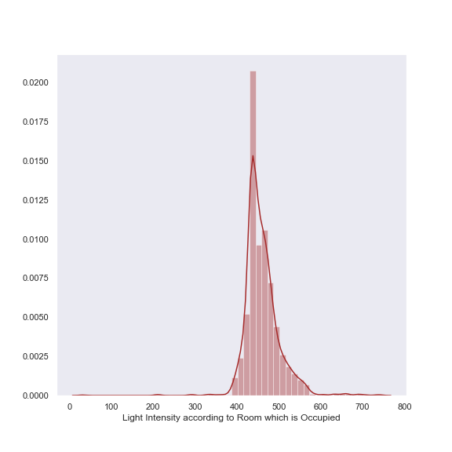
[NAME]
[Data Findings Continued...]
CO2 values for when room was occupied
Light Intensity values for when room was occupied

Slide 14

[NAME]
[Implications]
The occupancy of a room depends on the CO2 level, light and temperature.
It also depends on the hour of the day.
Rooms are occupied between the hours of 7am and 18:00 pm which may depict the working hours of the day.

Slide 15

[NAME]
[Deep Dive on Solution / Prototype]
Data is trained to predict room occupancy using three algorithms
Support Vector Machine
Two-Class Boosted Decision Tree
Two-Class Logistic Regression
Chosen algorithm is used to train a model
Inference Pipeline is created and deployed as a service

Slide 16

[NAME]
Metrics
The data was scrutinized using the precision metrics:
Organisation would not want gadgets and ventilators on, when there is nobody in the room.
Reduce false positives(FP) .
The target metric is precision; i.e. aiming to reduce false positives at all times.

Slide 17

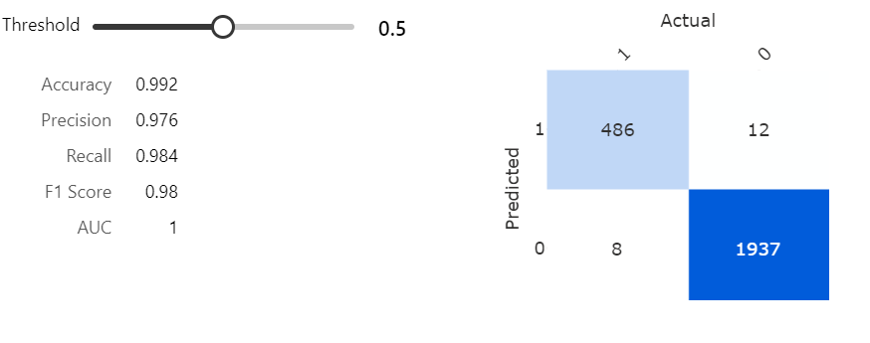
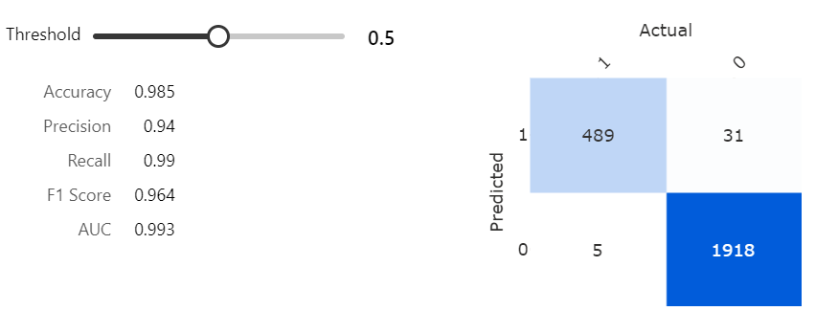
Metrics of algorithms
Two-Class Boosted Decision Tree
Two-Class Logistic Regression

Slide 18
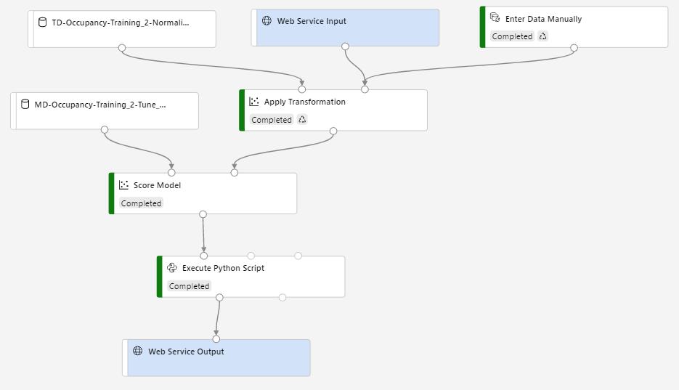
Deployed Pipeline

Slide 19

[NAME]
[Summary and Call for Action]
Key Points:
The design of actuator systems should be implemented taking into consideration the working periods and non-working periods.
Ranges to be considered in Actuator Triggers:
CO2 levels between 439 and 2028.5
Light intensity between 31<L<744
Sensor data parsed through the pipeline could be sent over a network protocol to a control device. Eg. Raspberry Pi

Slide 20


